Slide 1
Zoom drones
Analysis Request

Slide 2
Problem
Due to increased demand, our current data storage has proved inefficient. There are also issues with calculating cost in the Sales table. Additionally, we have seen an increase in part defects and are having difficulties identifying the source of the problem.

Slide 3
Request
We want our current data transferred to SSMS. Additionally, we request an analysis of our product defects. We want to know the source of the defects and how it is affecting our bottom line.

Slide 4
Solution
Transfer raw data into SSMS
Establish relationships between tables
Fix data errors (Cost column in Sales table/cost traceability)
Create a Summary View to facilitate further analysis
Create Stored Procedures to allow for future data entry
Create a live connection to Power BI
Create custom measures/tables with DAX
Design a dashboard that facilitates root-cause analysis
Create and present insights gained through analysis

Slide 5
DATABASE
Existing Data was transferred to SSMS.
Costs column was fixed to allow for accurate accounting.
New Stored Procedure were created to facilitate future data entry.
A Summary Running Summary View was created for up to date totals.

Slide 6
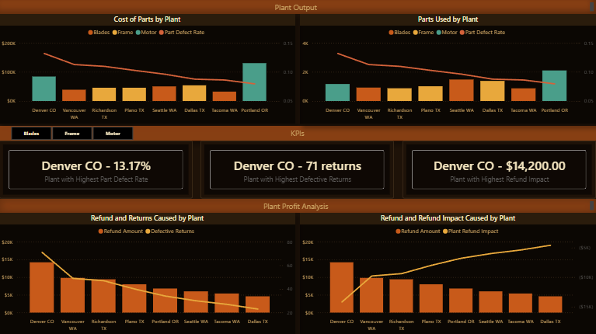
Dashboard

Slide 7

Contents
Plant Output: Tracks the costs of parts produced by each plant, and the number of parts produced alongside each plant's defect rate.
KPIs: 3 KPI cards that track the factory with the Highest Defect Rate, # of returns, and Refund Impact.
Plant Profit Analysis: Refund amount caused by each plant, alongside the amount of Defective Returns, and the Refund Impact.
Slicer: Filters entire dashboard by part type (Blades, Frame, Motor).

Slide 8
Key Plant Insights
Blades
Vancouver WA plant is the costliest, with an 11.27% Defect Rate, 49 returns, and $9800 worth of refunds.
Frame
Richardson TX plant is the costliest, with a 10.96% Defect Rate, 47 returns, and $9400 worth of refunds.
Motor
Denver CO plant is the costliest, with a 13.17% Defect Rate, 71 returns, and $14200 worth of refunds.

Slide 9
Recommendations
The Vancouver WA, Richardson TX, and Denver CO are the main drivers of returns for each of their part categories.
For Blades production shift business from Vancouver WA to Tacoma WA.
For Frame production shift business from Richardson TX to Dallas TX.
Key Recommendation: For Motor production shift business from Denver CO to Portland OR.

